Slide 1
Term Project
Applied Machine Learning
Group 12
Ahmed Al-Wasefy (300389391)
Ibrahim Elshenhapy (300389386)
Mohamed Gabr (300389919)

Slide 2
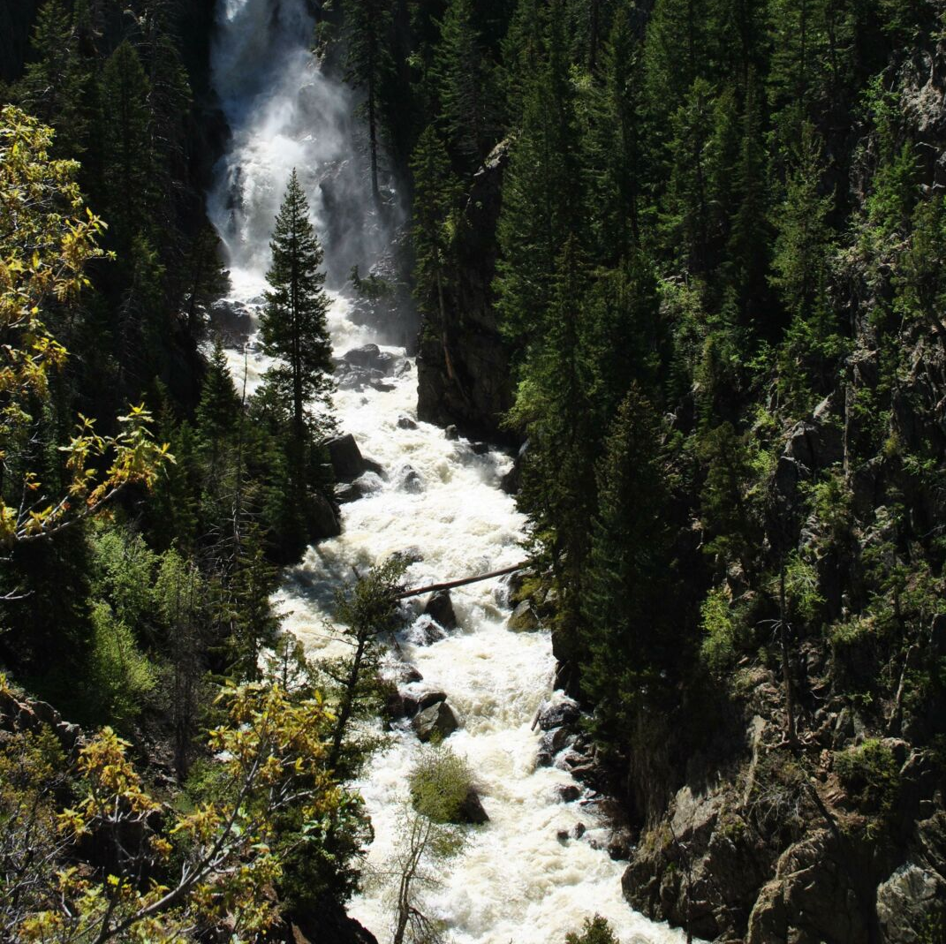
Problem’s Overview
In The Forest of northern Colorado

Slide 3
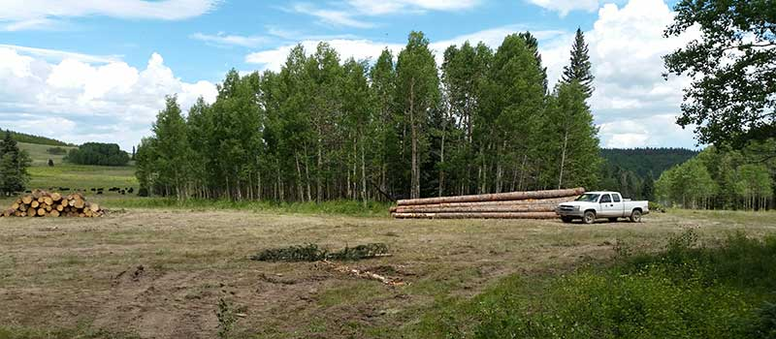
Problem’s Overview
Land Use Planning
Environment Protection
Forest Management

Slide 4
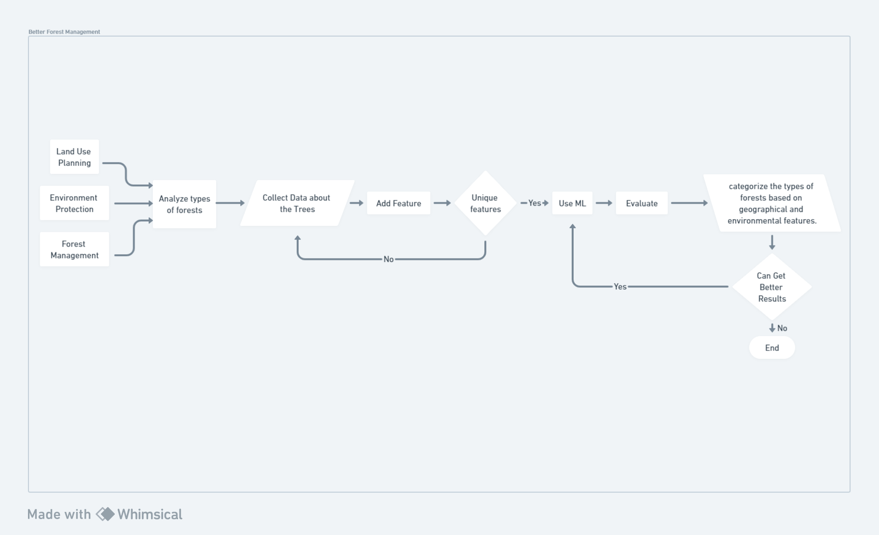
Problem’s Overview
Elevation
Aspect
Slope
Distance to Hydrology (Horizontal and Vertical)
Distance to Roadways
Hillshade (Different time)
Wilderness Area
Soil Type
Cover Type

Slide 5
Problem’s Overview
New Algorithms Developed

Slide 6
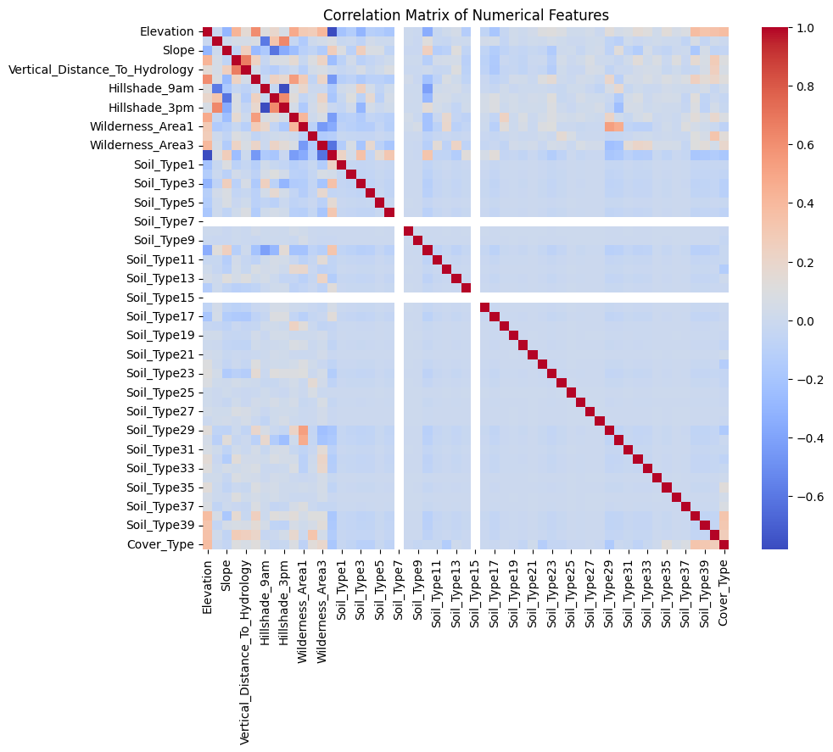
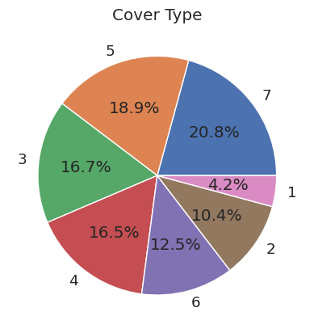
Dataset’s overview (EDA)

Slide 7
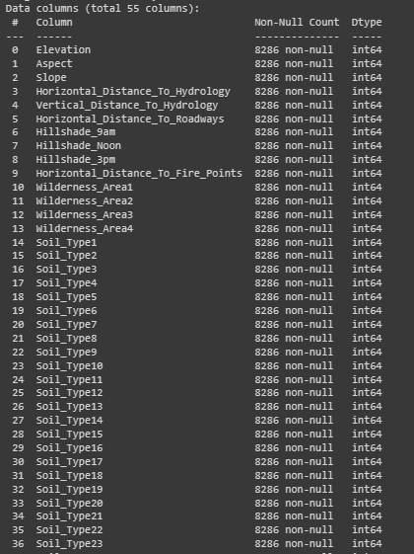
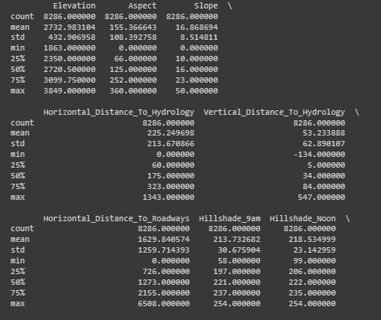
Dataset’s overview (EDA)

Slide 8
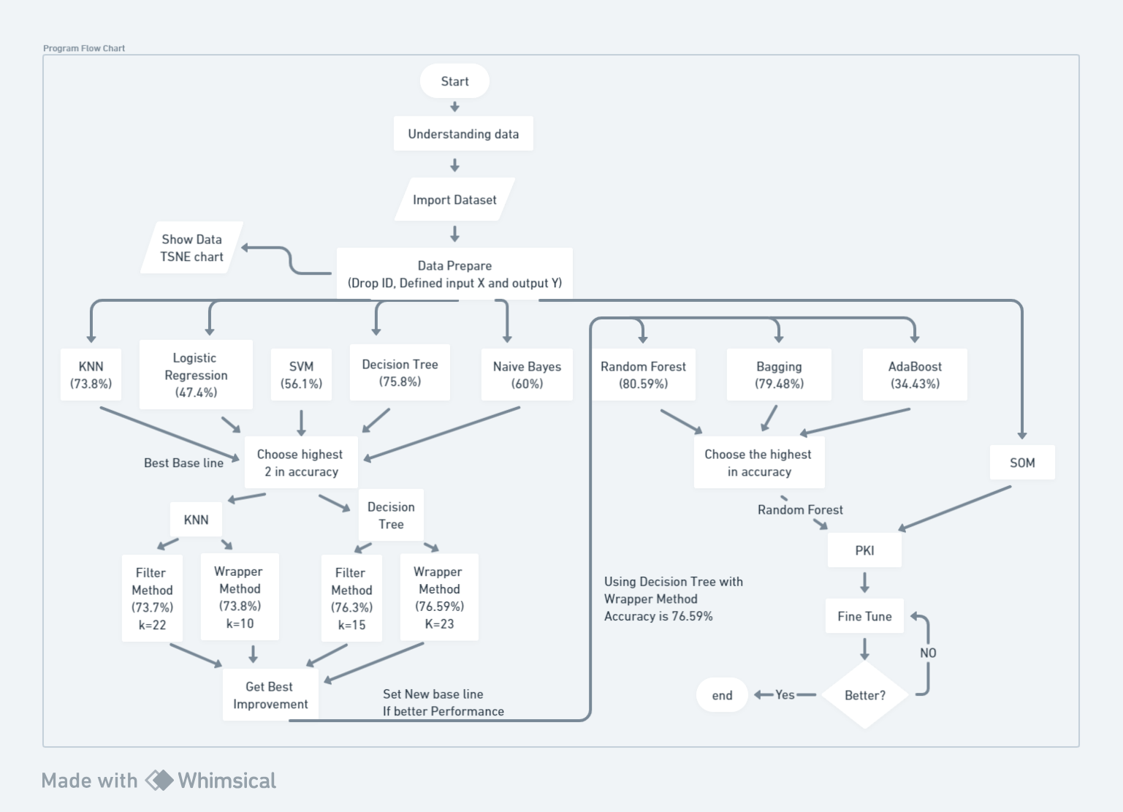
General Flowchart to summarize all process

Slide 9
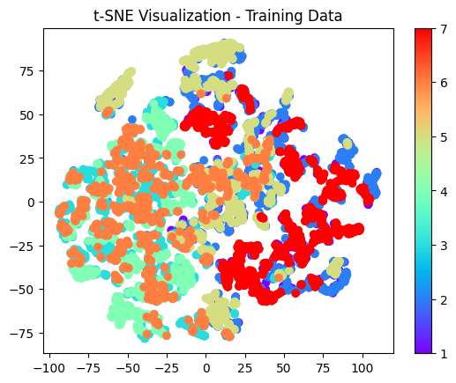
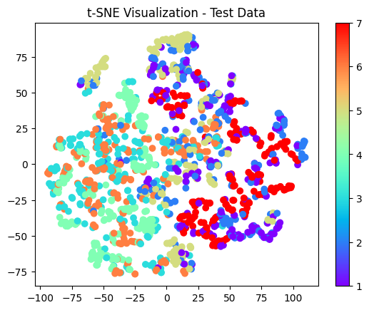
Visualize the training and test set to understand problem nature

Slide 10
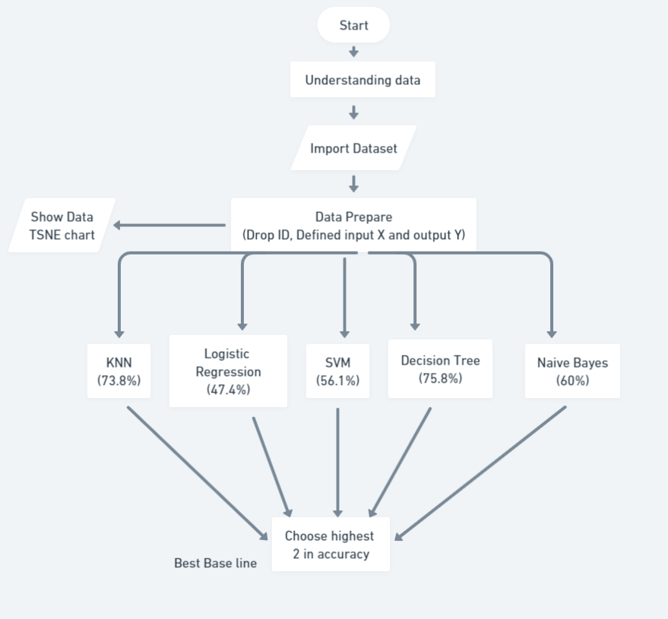
Flow Chart for Question 1

Slide 11
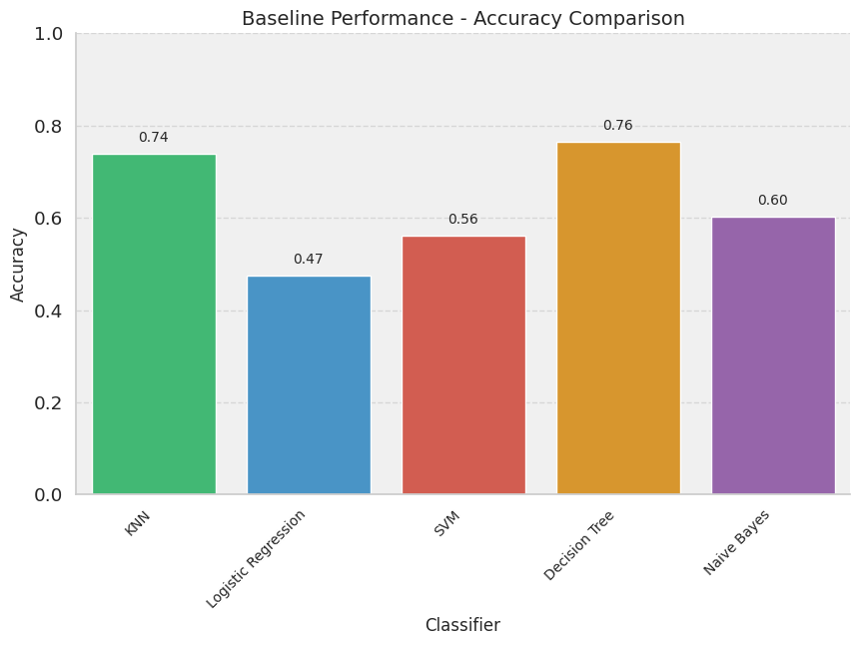
Obtain a baseline performance

Slide 12
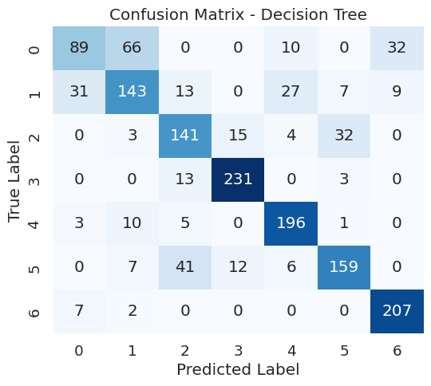
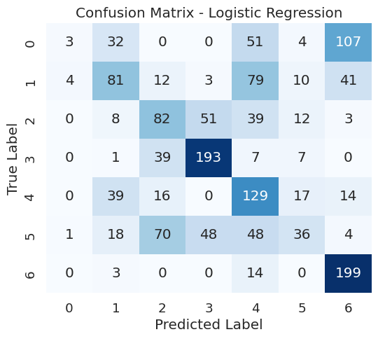
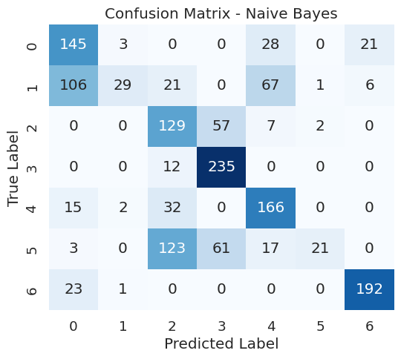
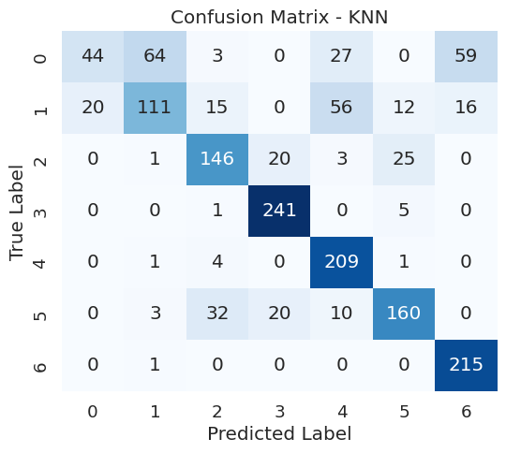
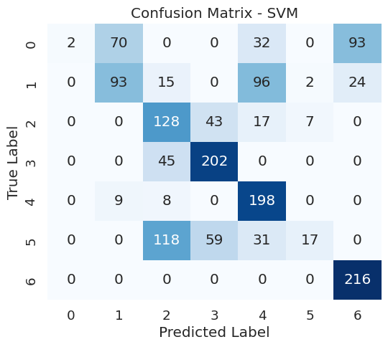

Slide 13
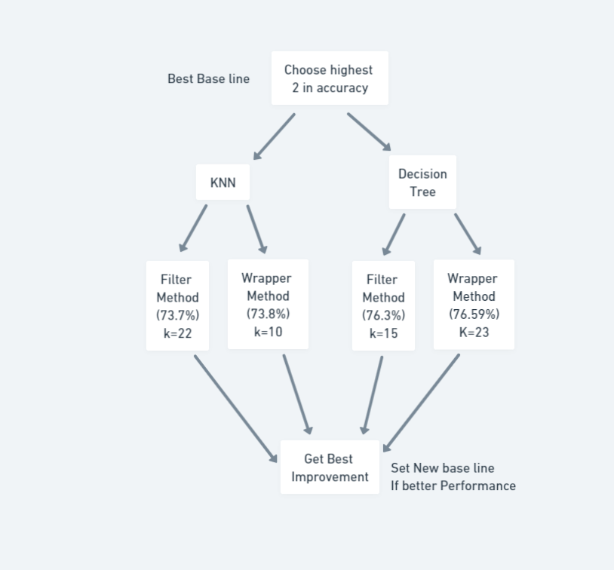
Flow Chart for Question 2

Slide 14
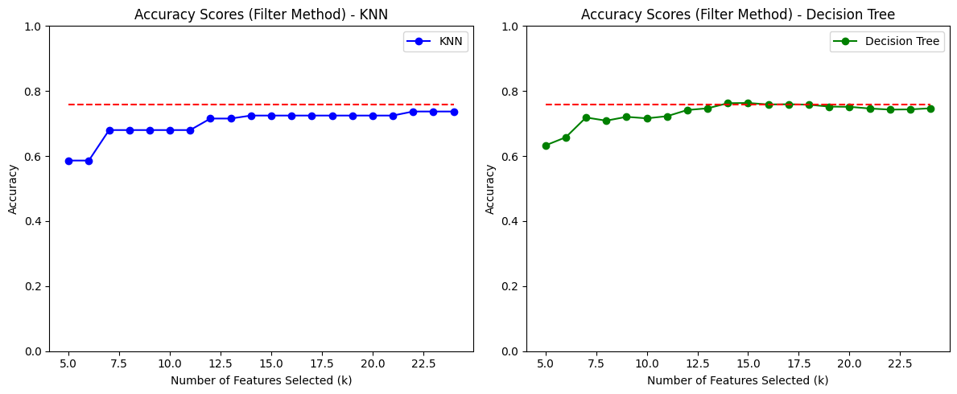
First Improvement strategy Feature Selection
K= (5 - 25)

Slide 15
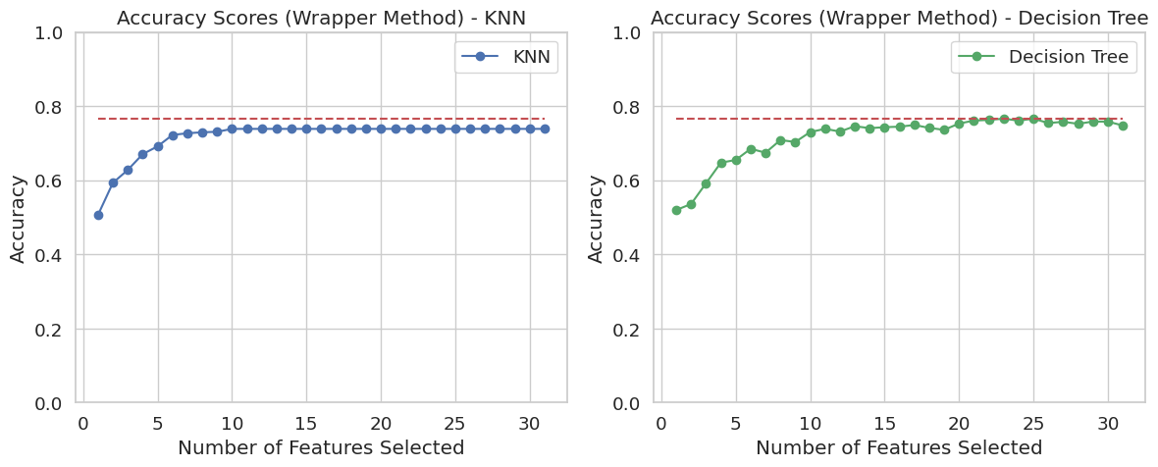
First Improvement strategy Feature Selection
K= (5 - 25)

Slide 16
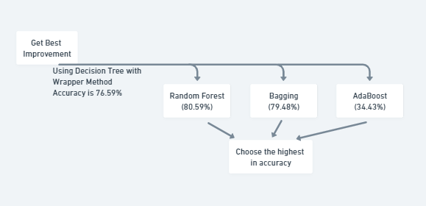
Flow Chart for Question 3

Slide 17
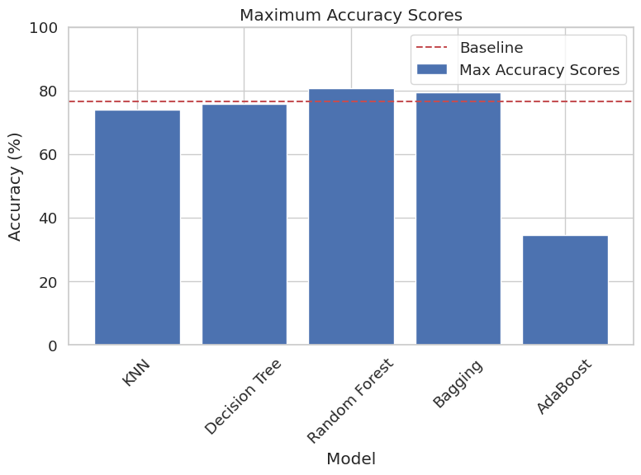
Adding more machine learning model

Slide 18
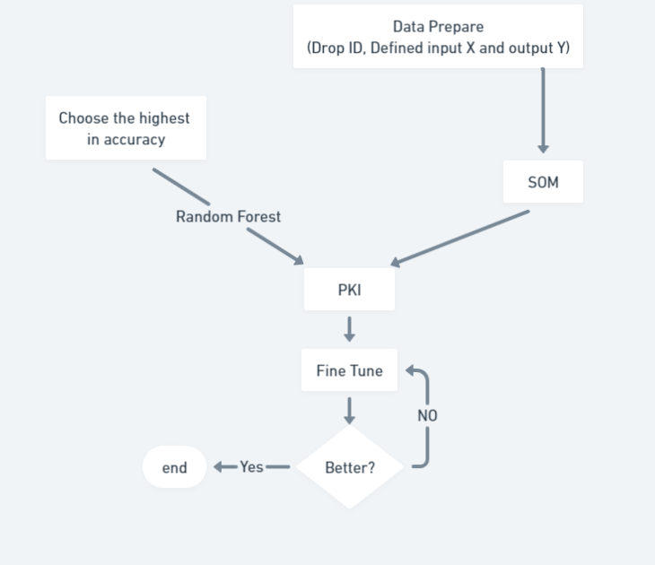
Flow Chart for Question 4,5

Slide 19
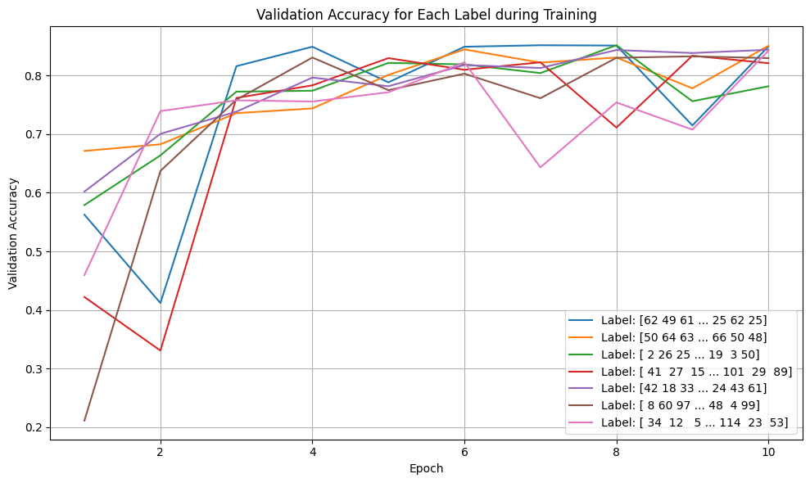
PKI

Slide 20
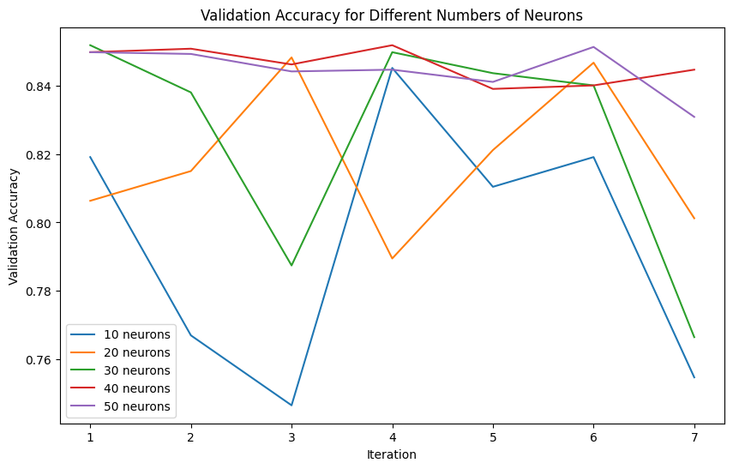
Fine tuning

Slide 21

Conclusion (Question1)
Decision Tree emerged as the best model with an accuracy of 76.2%.
KNN and Naive Bayes also performed reasonably well, achieving accuracies ranging from 0.6 to 0.76.
Logistic Regression and SVM showed relatively poor results, with low accuracies due to misclassifications in specific classes.
The most common misclassifications occurred in classes 0, 1, and 5.
Further experimentation using Dimensionality Reduction and Feature selection could improve the models' performance.
The obtained results serve as a starting point for enhancing the classifiers' accuracy on the dataset.
Overall, the current accuracies indicate room for improvement in future iterations.

Slide 22

Conclusion (Question 2)
The filter method for feature selection was implemented, selecting features based on individual importance without considering feature interactions.
Results indicate that the accuracy of both the KNN and Decision Tree models increases as the number of selected features increases, but plateaus after a certain threshold.
There are a few crucial features significantly contributing to the models' accuracy, while others have less impact.
Best k values for KNN and Decision Tree were found to be 22 and 15, respectively.
The accuracy of the KNN model with the best k value is 73.7%, and the Decision Tree model achieves 76.3%.
The filter method can be a valuable approach to enhance model accuracy, but careful selection of the optimal number of features is essential for best results.

Slide 23
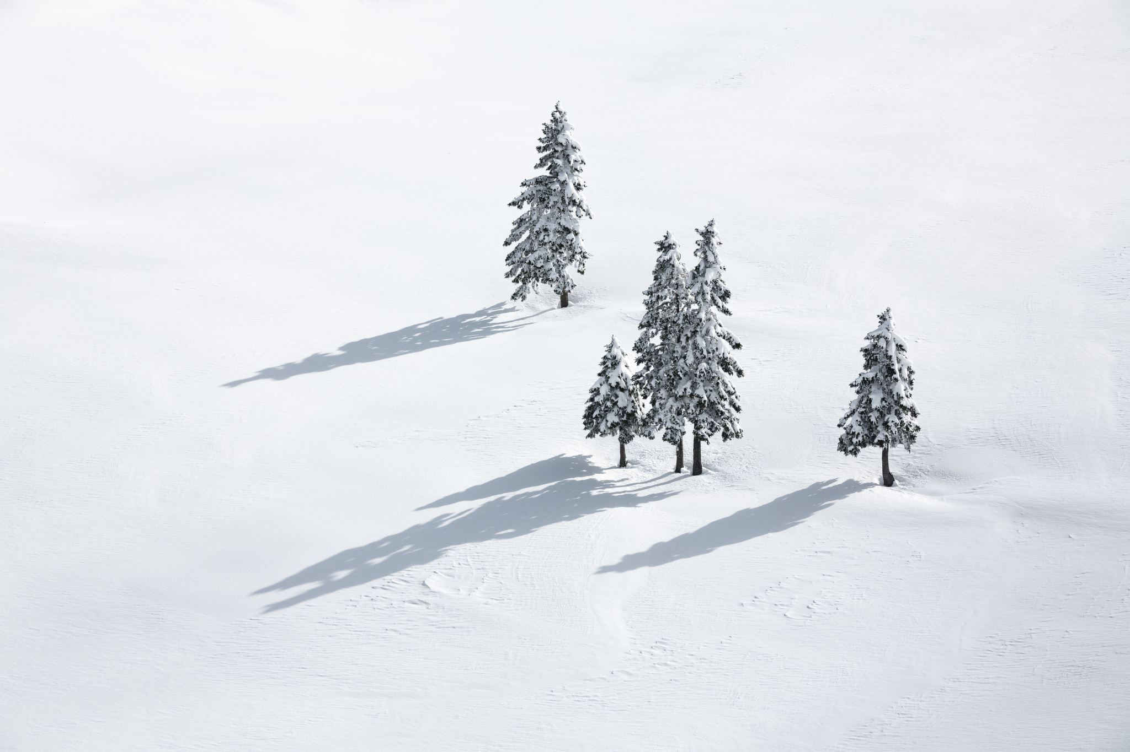
Conclusion (Question 2)
Implemented the wrapper method for feature selection using Recursive Feature Elimination with Cross-Validation (RFECV) algorithm.
The wrapper method iteratively adds features to the model and evaluates its performance, improving accuracy for both KNN and Decision Tree models.
Best k values for KNN and Decision Tree are 10 and 23, respectively, with accuracies of 0.738 and 0.766.
The accuracy of models plateaus after selecting a certain number of features, indicating important features and less significant ones.
The wrapper method is a valuable approach to enhance model accuracy, though more complex to implement compared to the filter method.
In comparison, the wrapper method proves to be more powerful, but the choice between the two depends on the specific problem requirements.

Slide 24
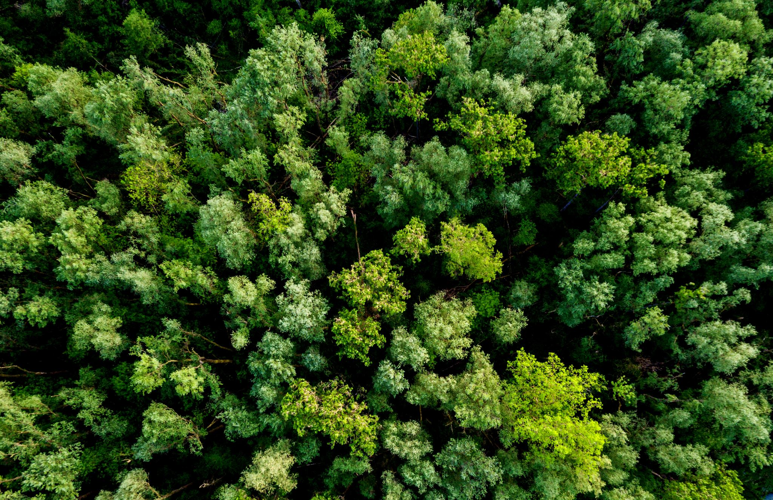
Conclusion (Question 3)
Implemented ensemble methods to improve model accuracy, including KNN, Decision Tree, Random Forest, Bagging, and AdaBoost.
Results show that Random Forest achieved the highest accuracy at 80.59%, followed by Bagging at 79.48%.
KNN and Decision Tree achieved moderate accuracies of 73.84% and 75.80%, respectively.
AdaBoost had the lowest accuracy at 34.43%.
Ensemble methods, particularly Random Forest and Bagging, are effective in enhancing model accuracy compared to baseline.
The choice of the best model depends on specific problem requirements - Random Forest for highest accuracy and Decision Tree for interpretability.

Slide 25
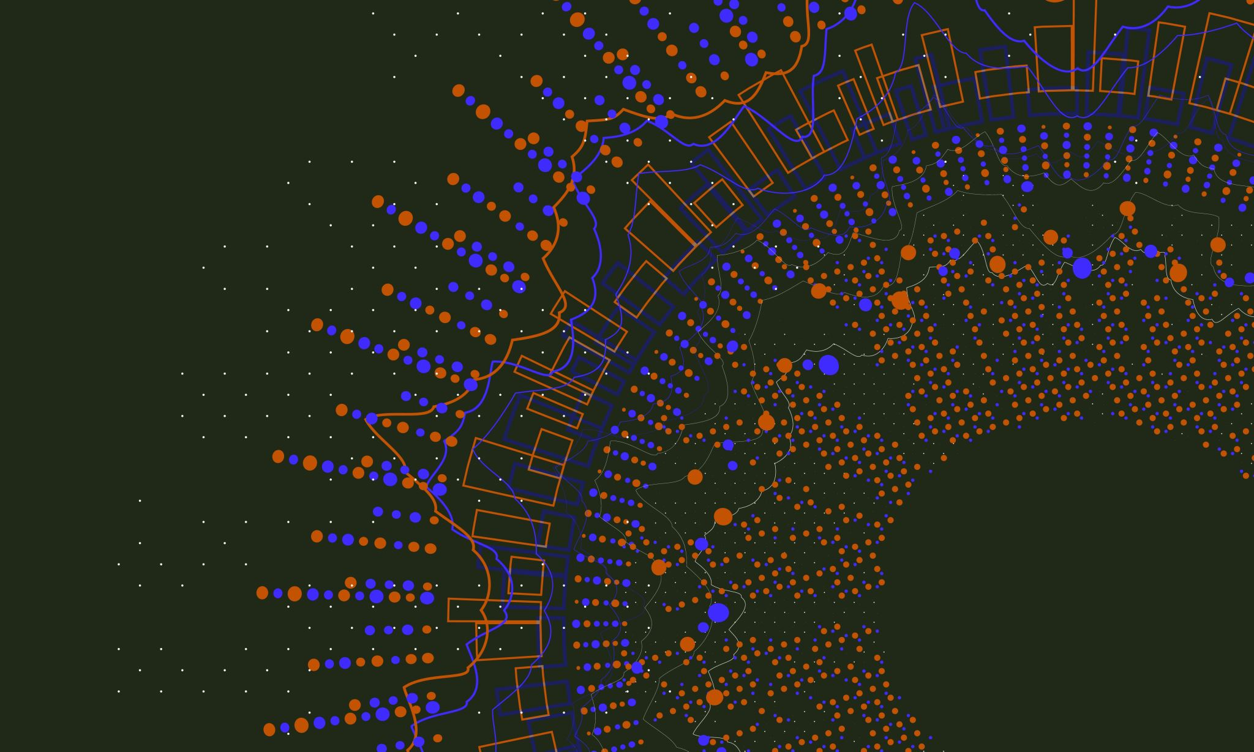
Conclusion (Question 4)
Implemented a Self-Organizing Map (SOM) for clustering the data into 7 regions.
Trained a Deep Neural Network (DNN) on the SOM cluster labels, achieving a validation accuracy of 85.18%.
DNN trained on the original data labels had a lower validation accuracy of 72.82%, indicating the effectiveness of SOM clustering.
Best validation accuracy achieved with a 6x6 grid of SOM neurons, suggesting larger grids may further improve DNN performance.
SOM clustering identified meaningful data patterns, enhancing DNN learning and performance.
Potential improvements include using a more sophisticated SOM algorithm (e.g., GrowingSOM), utilizing convolutional neural networks (CNNs), and exploring various data preprocessing and regularization techniques to optimize DNN performance.

Slide 26

Conclusion (Question 5)
The improved code incorporates two additional callbacks, ReduceLROnPlateau and Early Stopping, to improve the accuracy of the Deep Neural Network (DNN) model during training.
The model architecture includes Batch Normalization and Dropout layers to stabilize training, prevent overfitting, and improve convergence.
The Adam optimizer with a learning rate of 0.001 is used for optimization, enhancing the model's ability to converge efficiently.
The utilization of Self-Organizing Maps (SOM) for data mapping allows the DNN to handle complex data distributions and capture intricate patterns, leading to better data representation.
Early Stopping prevents overfitting by monitoring the validation loss and stopping training when there is no improvement for a certain number of epochs.
ReduceLROnPlateau reduces the learning rate when the validation loss plateaus, fine-tuning the model and aiding convergence.
The combination of these techniques results in a more accurate DNN model compared to the previous version, as it prevents overfitting, fine-tunes the model, and enhances data representation and feature learning.

Slide 27
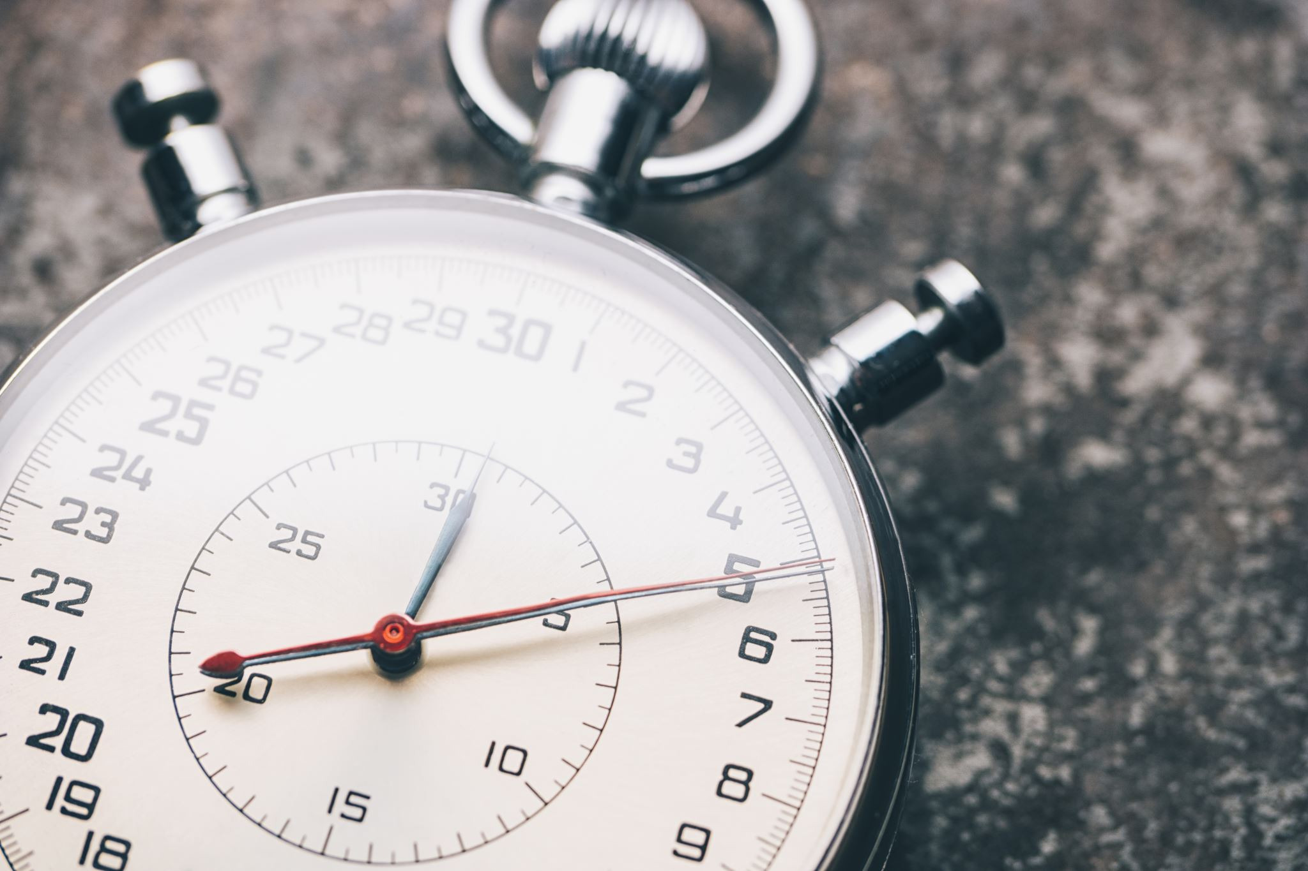
Thanks

